Slide 1

Instructor: NGUYEN ANH MINH, MSc, PMP

Slide 2
Project Time Management

Slide 3

Agenda
6.1 Plan Schedule Management
6.2 Define Activities
6.3 Sequence Activities
6.4 Estimate Activity Resources
6.5 Estimate Activity Durations
6.6 Develop Schedule
6.7 Control Schedule

Slide 4
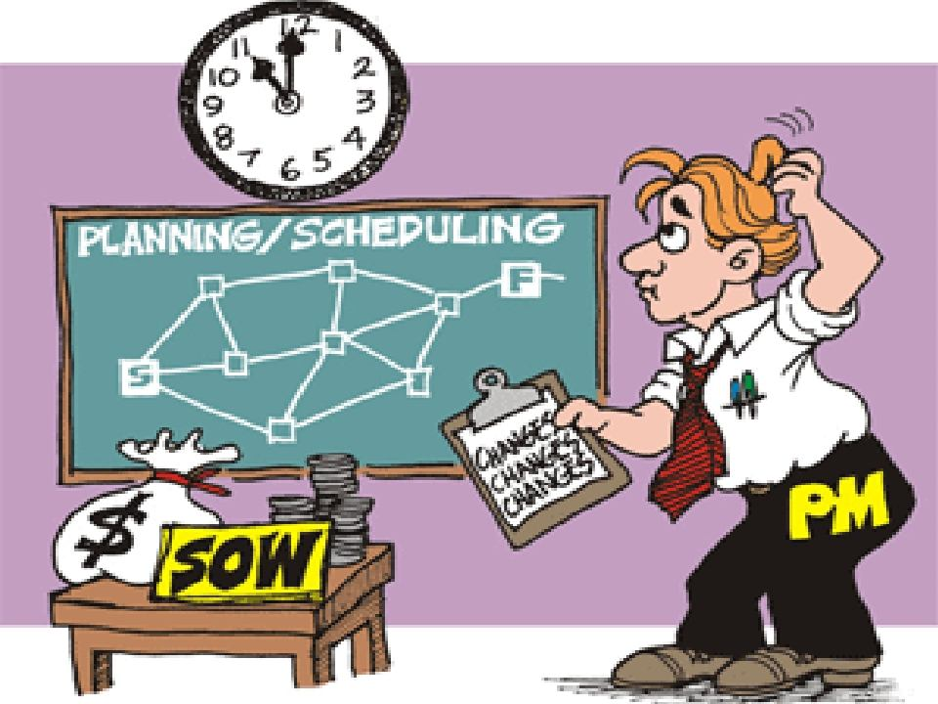

Slide 5
Project Time Management
Includes the processes required to
accomplish timely completion of the project; involved 7 processes used to in developing time schedule
The schedule can have any format.

Slide 6
6.1 Plan Schedule Management
Establishing the policies, procedures, and documentation for planning, developing, managing, executing, and controlling the project schedule.
The key benefit is to provide guidance and direction on how the project schedule will be managed.

Slide 7
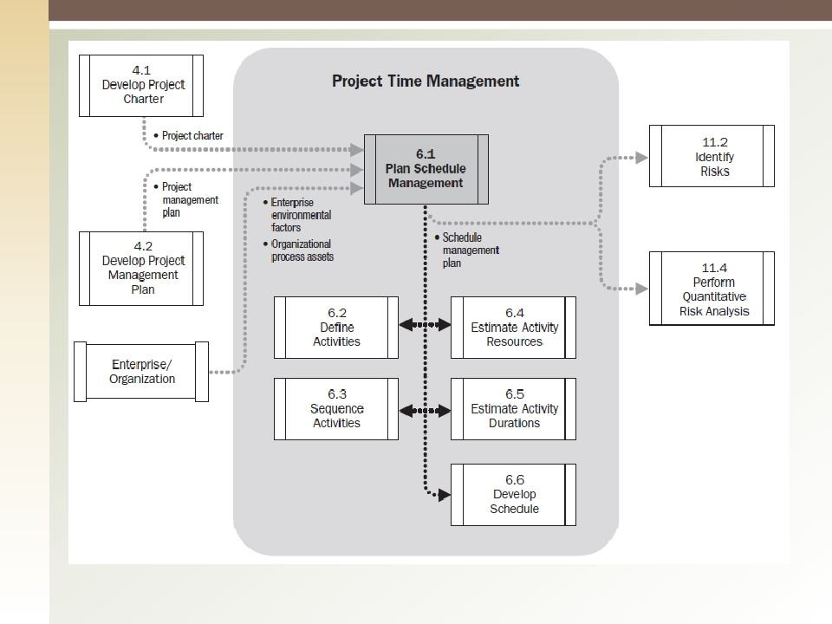
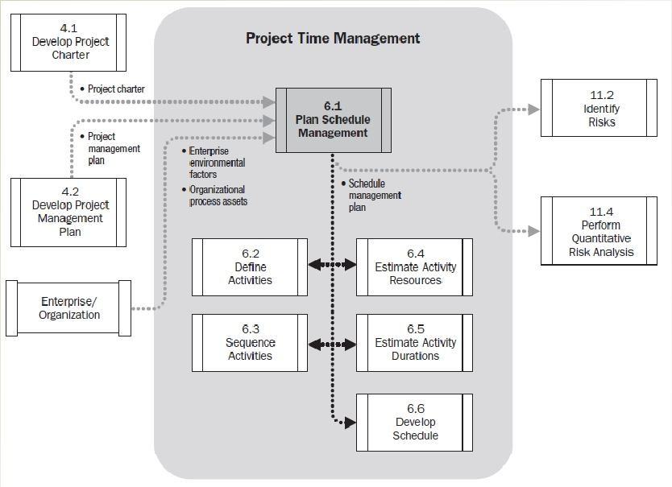
6

Slide 8
Plan Schedule Management: Inputs
Project Management Plan
Scope baselines
Other Information
Project Charter
Enterprise Environmental Factors
Organization Process Assets

Slide 9
Plan Schedule Management: T & T
Expert Judgment
Analytical Techniques
Meetings

Slide 10
Plan Schedule Management: Output
Schedule Management Plan, includes but not limited to:
Project Schedule Model Development
Level of accuracy
Rules of Performance Management
Reporting Formats
Process Description
9

Slide 11
6.2 Define Activities
Identify the specific actions to be performed to
produce the project deliverables
Activities provide a basis for estimating, scheduling, executing and monitoring and controlling the project work.

Slide 12
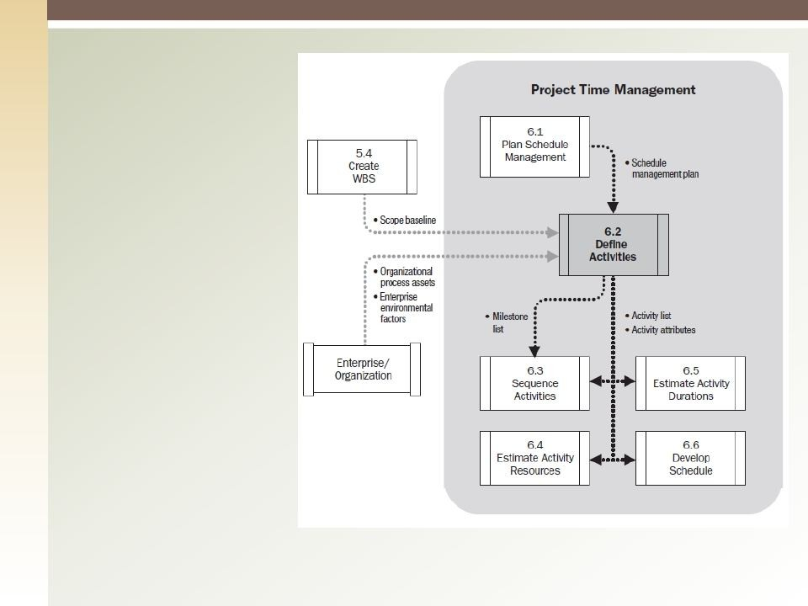
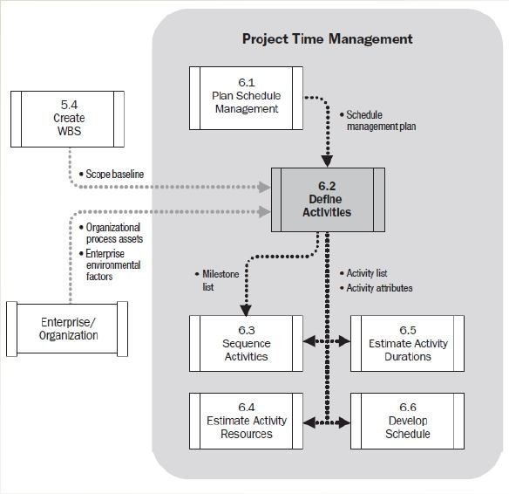
Define Activities Data Flow

Slide 13
Define Activities: Inputs
Schedule Management Plan
Scope baselines
Enterprise Environmental Factors
Organizational Process Assets

Slide 14
Define Activities: T & T
Decomposition
Rolling Wave Planning
Expert Judgment

Slide 15
Define Activities: Outputs
Activity List: A list of all the activities that will
be performed on the project and a description of each activity
Activity Attributes
Milestone List: A milestone is a significant point or event in project.

Slide 16
6.3 Sequence Activities
The process of identifying and documenting relationships among the project activities.
Lead/Lag time between activities should be considered to support a realistic schedule.
Can be performed by a software or
manually.

Slide 17
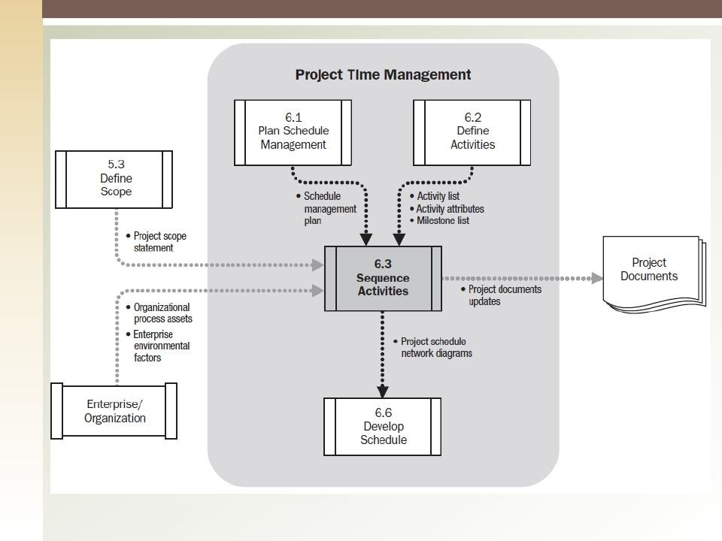
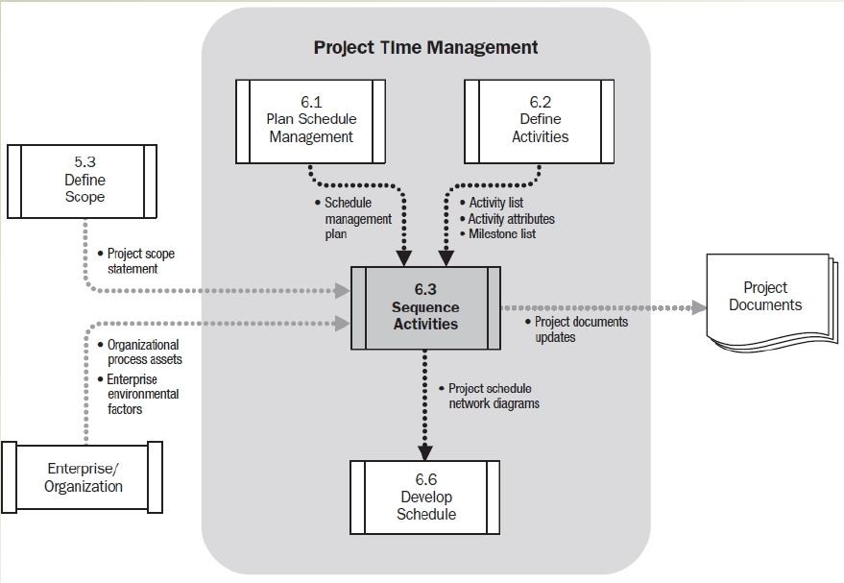

Slide 18
Sequence Activities: Inputs
Schedule Management Plan
Activity List
Activity Attributes
Milestone List
Project Scope Statement
Enterprise Environmental Factors
Organizational Process Assets

Slide 19
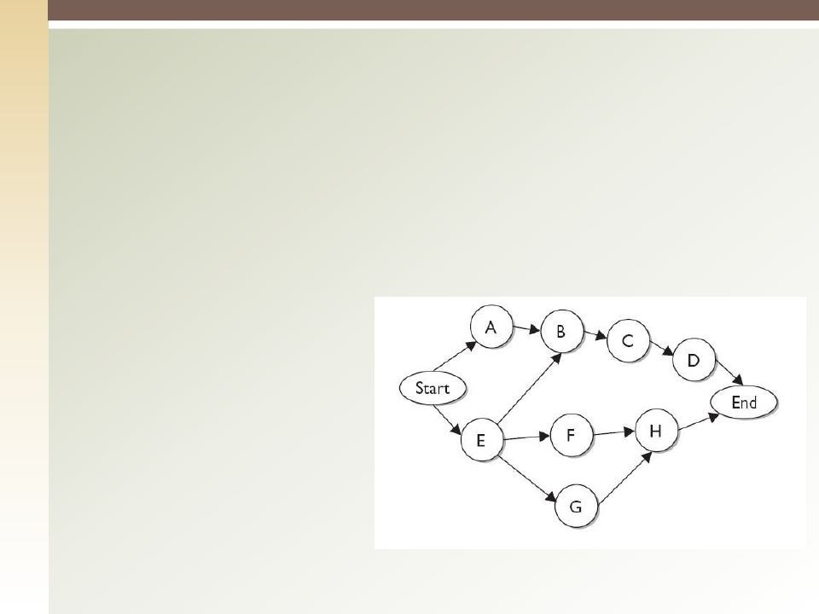
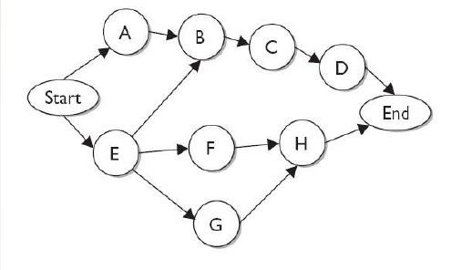
Sequence Activities: T & T
1. Precedence Diagramming
The most common method of arranging the
project activities visually. Activities are put in boxes, called nodes,
and connected with
arrows (Activity on Node).

Slide 20
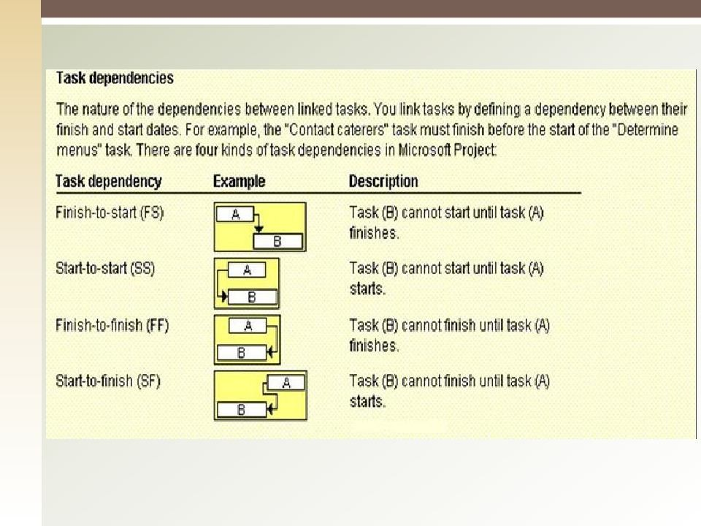
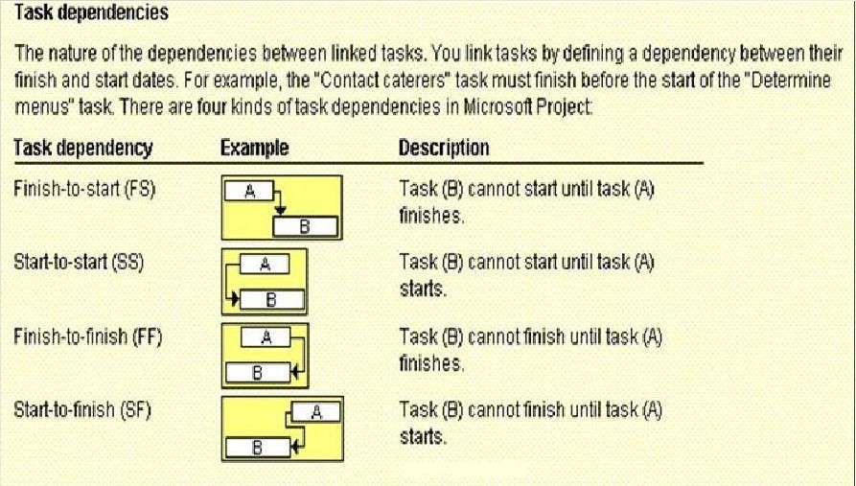

Slide 21
Sequence Activities: T & T
Dependency Determination
Mandatory Dependency
Discretionary dependency: preferred logic, preferential logic, or soft logic.
External dependencies

Slide 22
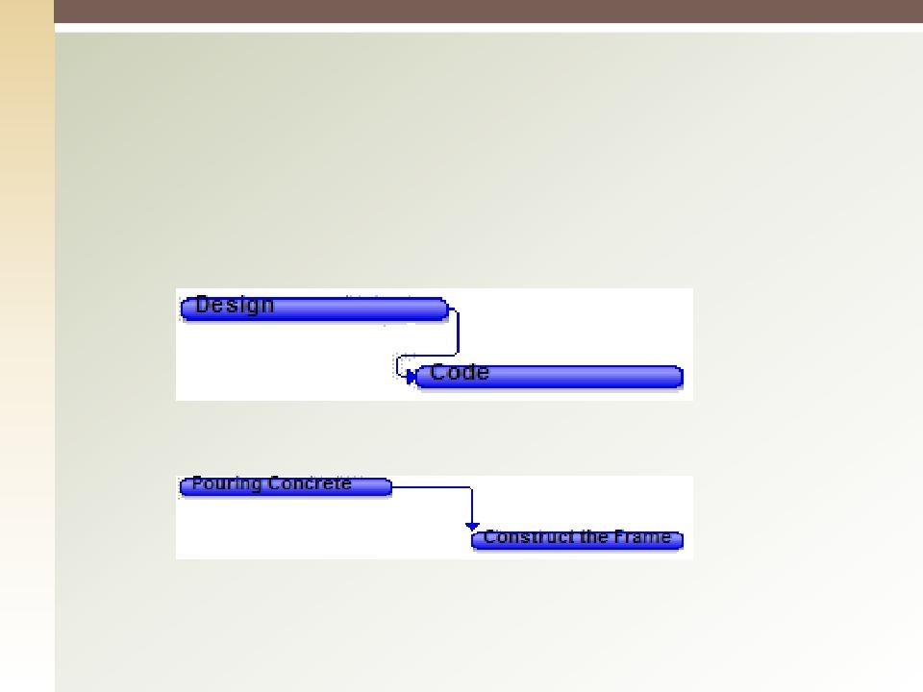


Sequence Activities: T & T
3. Applying Leads an Lags

Slide 23
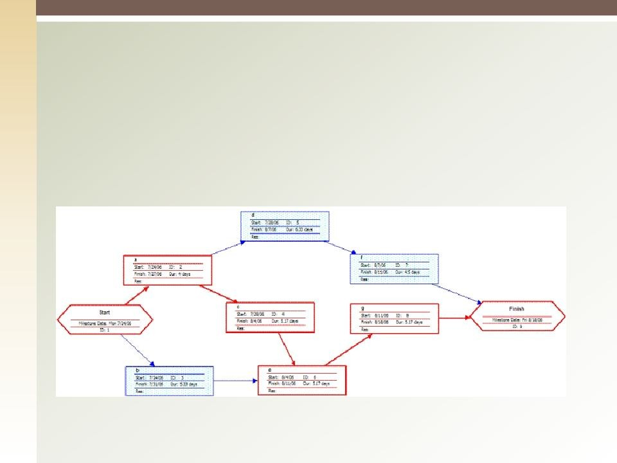
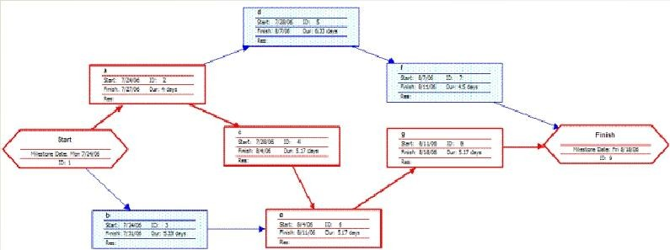
Sequence Activities: Outputs
Project Schedule Network Diagrams
Project Document Updates

Slide 24
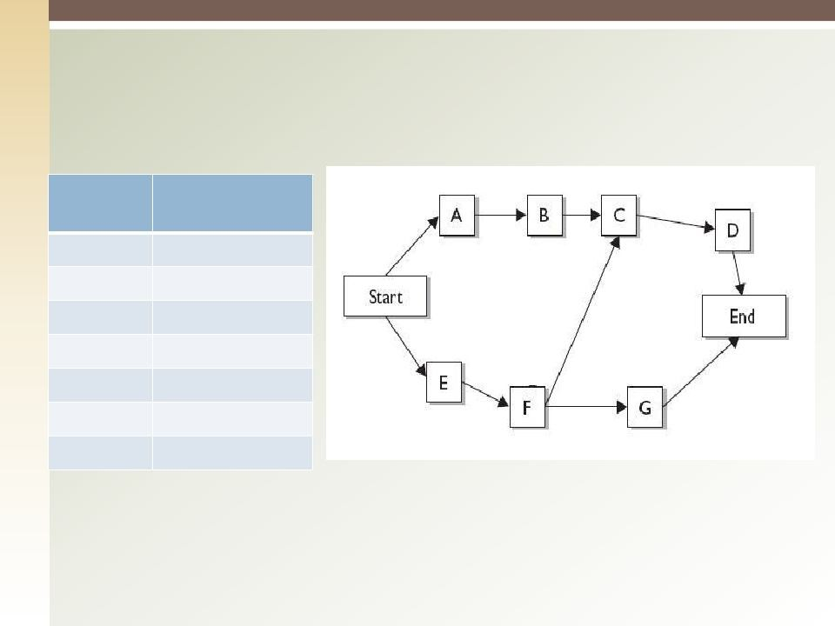
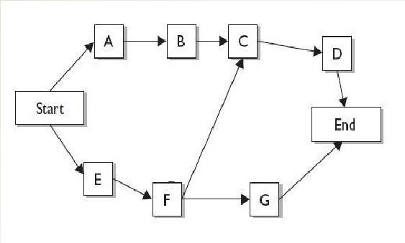
Exercise
Activity | Predecessor
A | -
B | A
C | B, F
D | C
E | -
F | E
G | F

Slide 25
6.4 Estimate Activity Resources
Estimate the type and quantities of material, human resources, equipment, or supplied required to perform each activity.

Slide 26
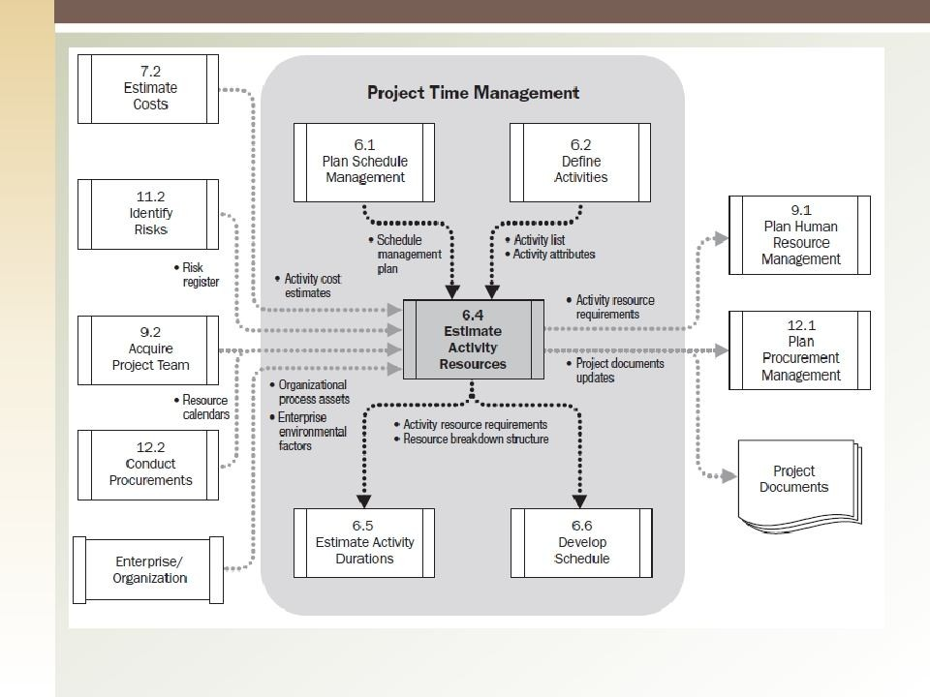
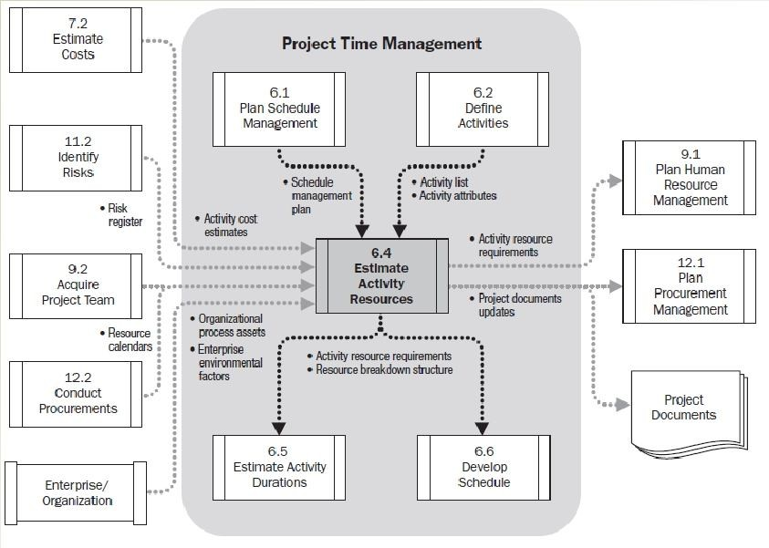

Slide 27
Estimate Activity Resources: Inputs
Schedule Management Plan
Activity List
Activity Attributes
Resource Calendars
Risk Register
Activity Cost Estimates
Enterprise Environmental Factors
Organizational Process Assets

Slide 28
Estimate Activity Resources: T & T
Expert Judgment
Alternatives Analysis
Published Estimating Data
Bottom-up Estimation
Project Management Software

Slide 29
Estimate Activity Resources: Outputs
Activity Resource Requirements
Resource Breakdown Structure
Project Document Updates

Slide 30


Quiz
“Determining the physical resources, quantities of each and when they would be used” is called
Resources Selection.
Resource leveling.
Resource Breakdown Structure (RBS).
Estimate Activity Resources.

Slide 31
6.4 Estimate Activity Duration
The process of approximating the number of work periods needed to complete individual activities with estimated resources.

Slide 32
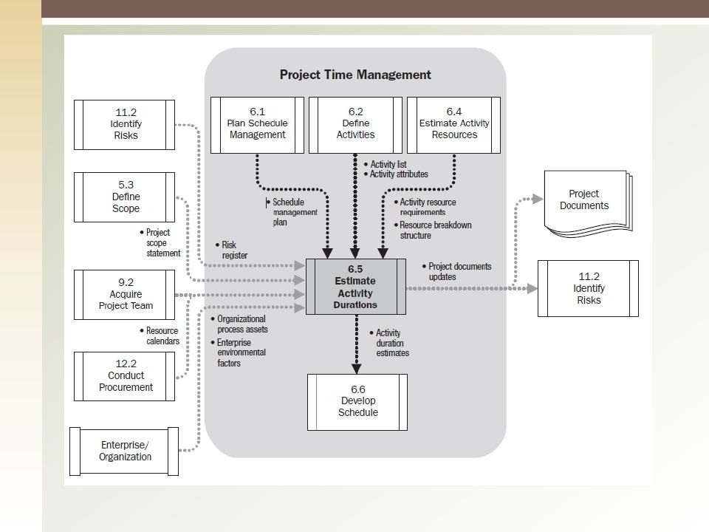
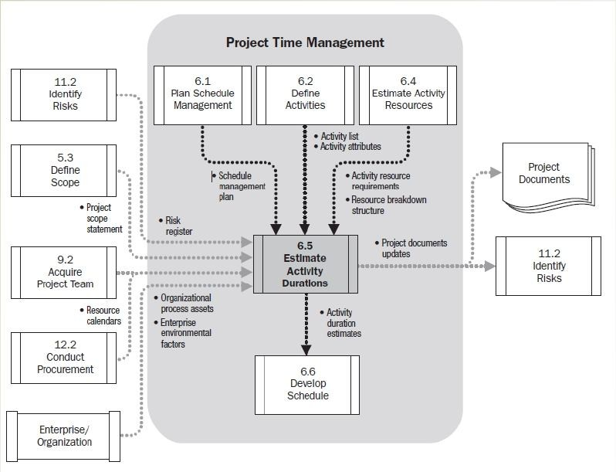

Slide 33
Estimate Activity Duration: Inputs (1)
Schedule Management Plan
Activity List.
Activity Attributes
Activity Resource Requirements
Resource Calendar

Slide 34
Estimate Activity Duration: Inputs (2)
Scope Statement
Risk Register
Resource Breakdown Structure
Enterprise Environmental Factors 10.Organization Process Assets

Slide 35
Estimate Activity Duration: T & T (1)
Expert Judgment
Analogous Estimating (Top-down) - Use actual values of a similar project
Parametric Estimating
Group Decision making techniques
Reserve Analysis

Slide 36
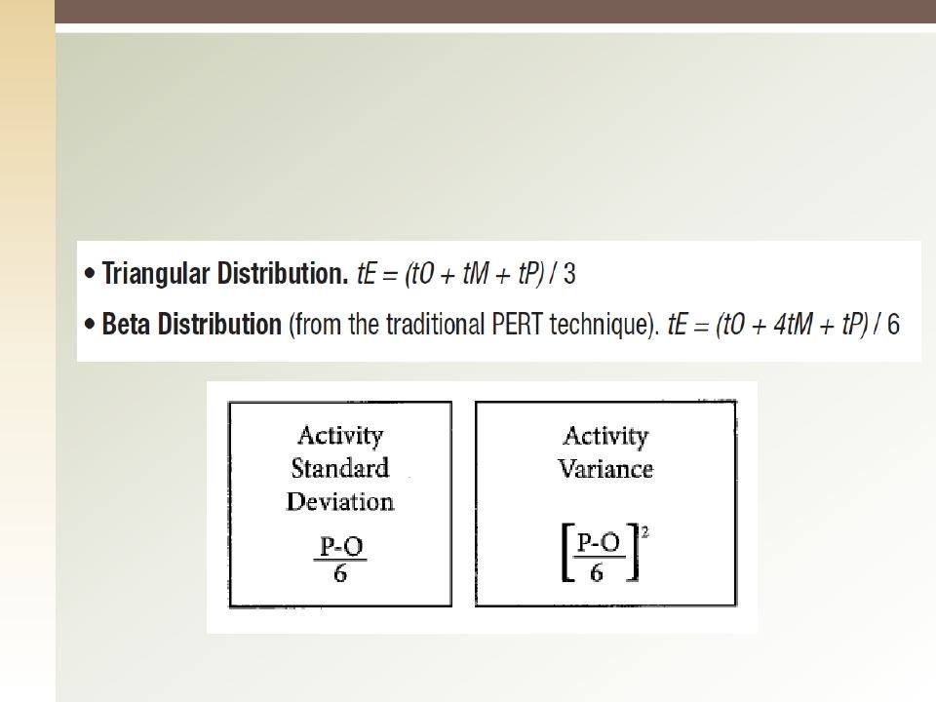
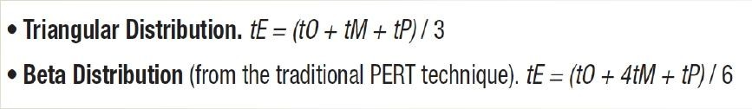
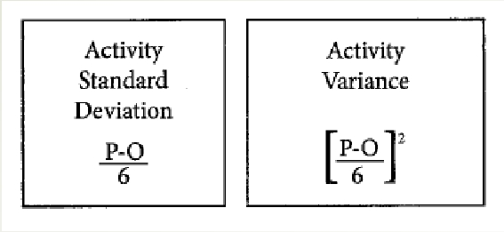
Estimate Activity Duration: T & T (2)
6. Three-point Estimate

Slide 37
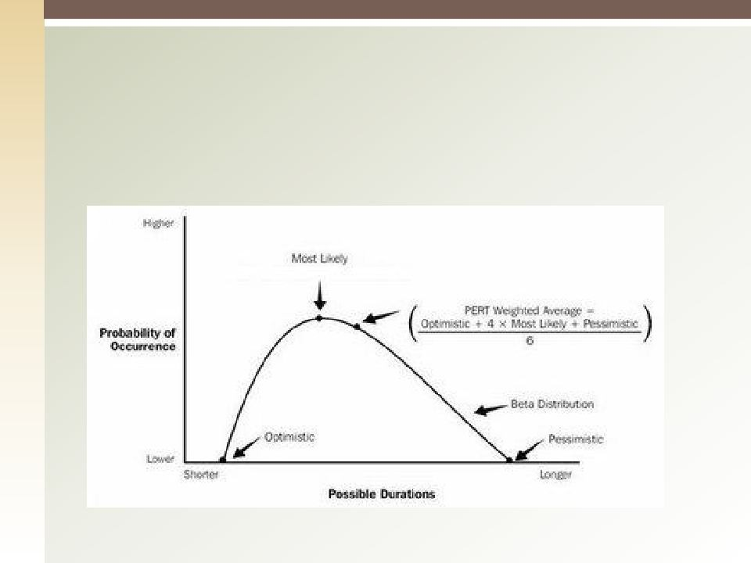
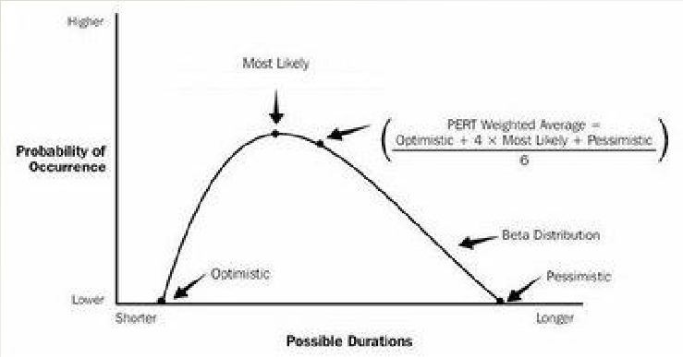
Program Evaluation & Review Technique (PERT) Uses a weighted average duration estimate to calculate activity durations.

Slide 38
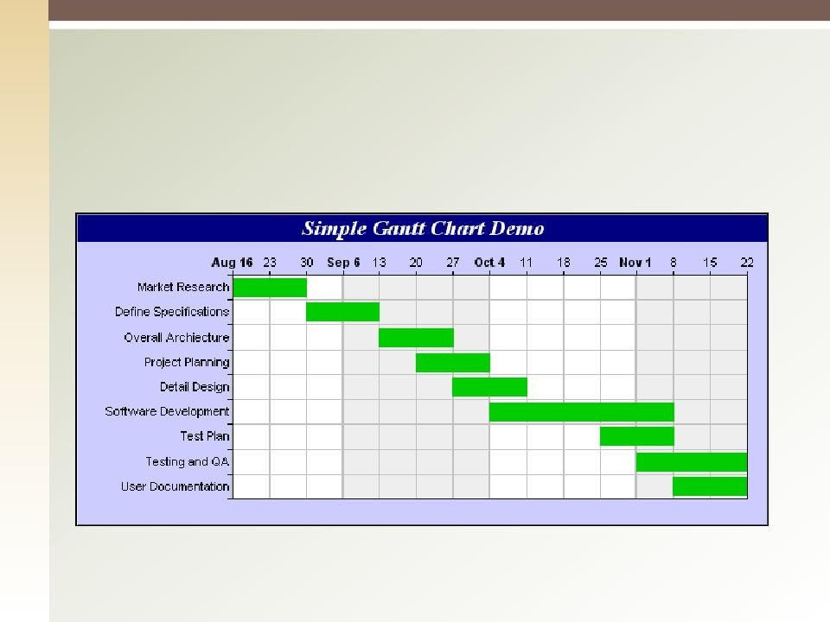
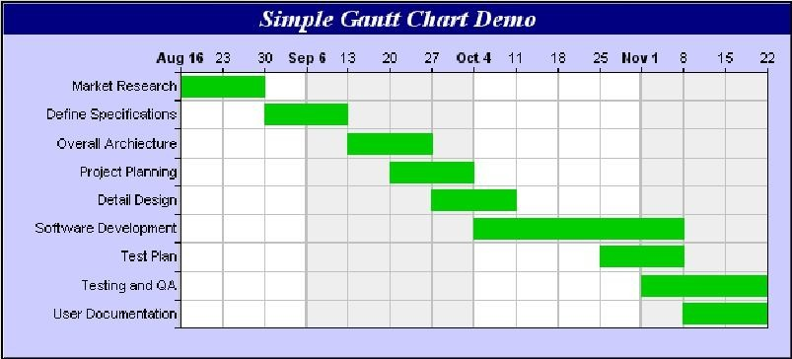
Gantt Chart
Bar charts are relatively easy to read, and are frequently used in management presentations.

Slide 39
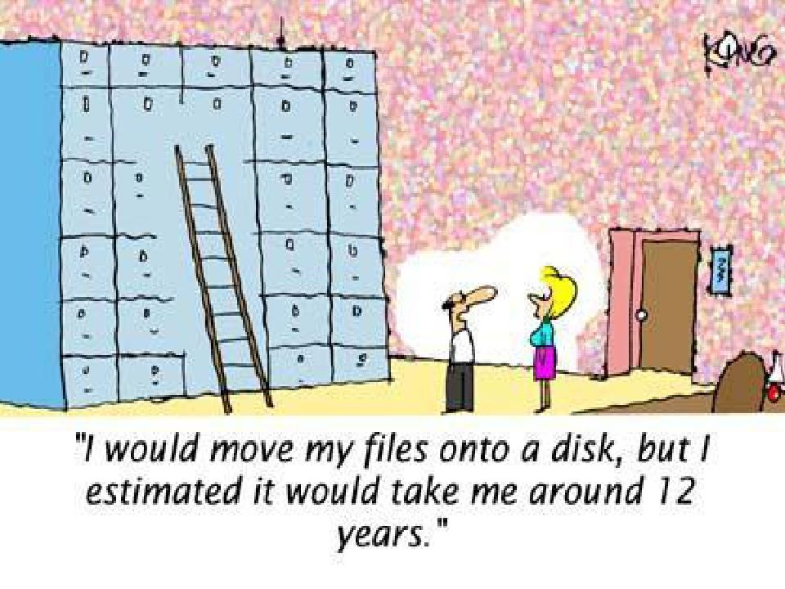

Slide 40
Estimate Activity Duration: Outputs
Activity Duration Estimates: Quantitative
estimates of the likely duration of each activity as well as the range of possible results ( 10 ± 2 day )
Project Document Updates

Slide 41


Quiz
The optimistic estimate is 1, the pessimistic
estimate is 9 & the most likely estimate is 8. What is the PERT estimate?
9
7
8
6

Slide 42
6.6 Develop Schedule
The process of analyzing activity
sequence, durations, resource requirements, & schedule constraints to create a project schedule.
Developing an acceptable schedule is often an iterative process.

Slide 43
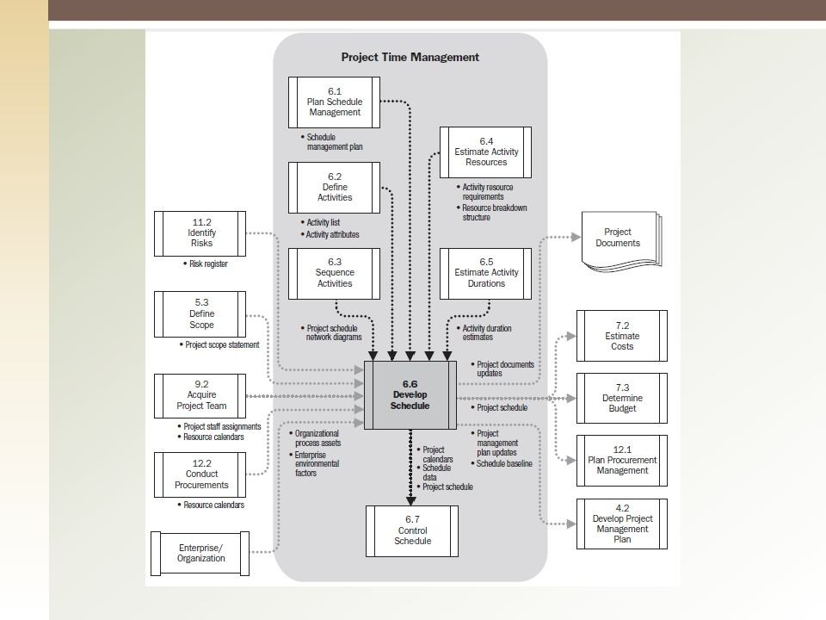
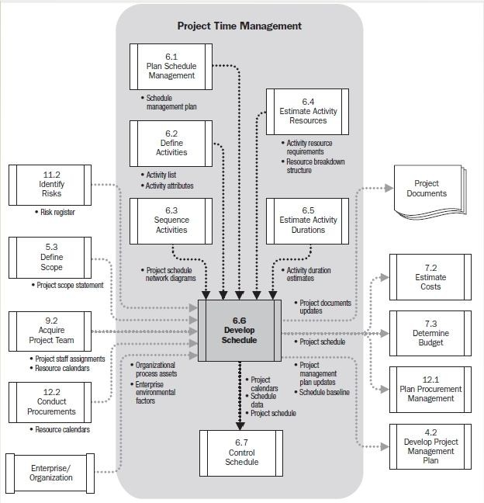

Slide 44
Develop Schedule: Inputs (1)
Schedule Management Plan
Activity List
Activity Attributes
Project Schedule Network Diagrams
Activity Resource Requirements
Resource Calendars
Activity Duration Estimates

Slide 45
Develop Schedule: Inputs (2)
Project Scope Statement
Risk Register
Project Staff Assignment 11.Resource Breakdown Structure 12.Enterprise Environmental Factors 13.Organizational Process Assets

Slide 46
Develop Schedule: T & T
Schedule Network Analysis
Critical Path Method
Critical Chain Method
Resource Optimization Techniques
Resource Leveling
Resource Smoothing

Slide 47
Develop Schedule: T & T
Modeling Techniques
What-if scenario analysis
Simulation
Leads and Lags
Schedule Compression
Crashing
Fast tracking
Scheduling Tools

Slide 48
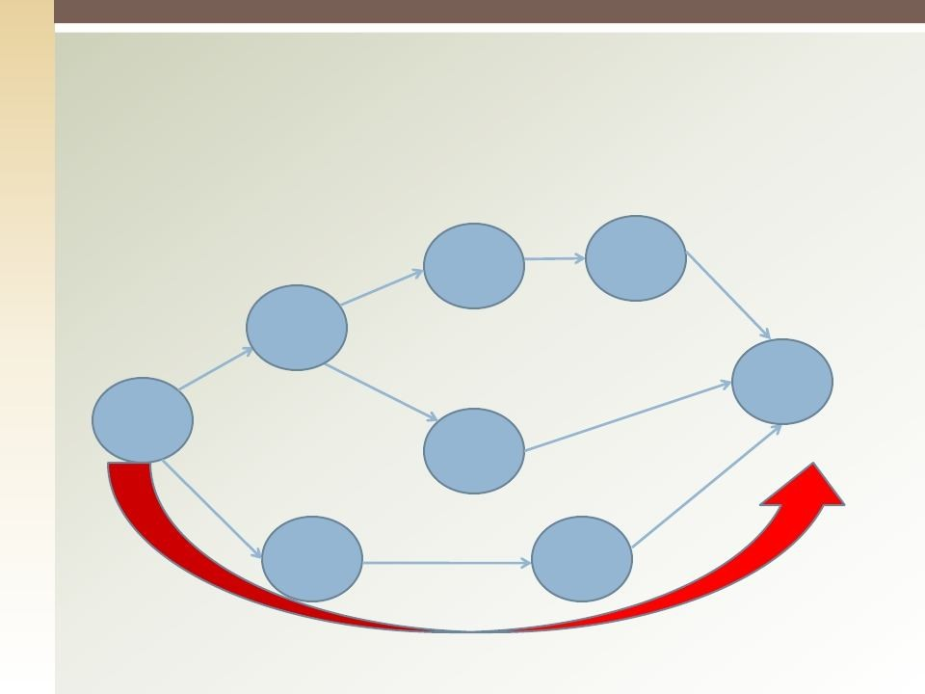




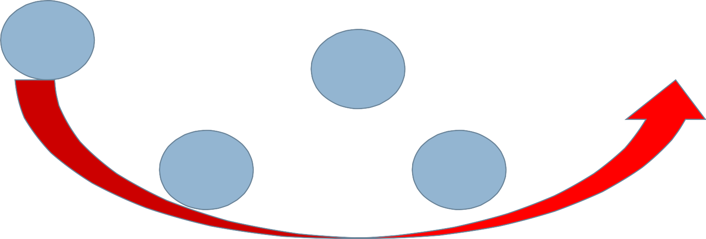


Critical Path
The longest duration path through a network diagram which represents the shortest time to complete the
project
E:2
H:2
A:2
End
Start
D:2
B:3
C:4

Slide 49
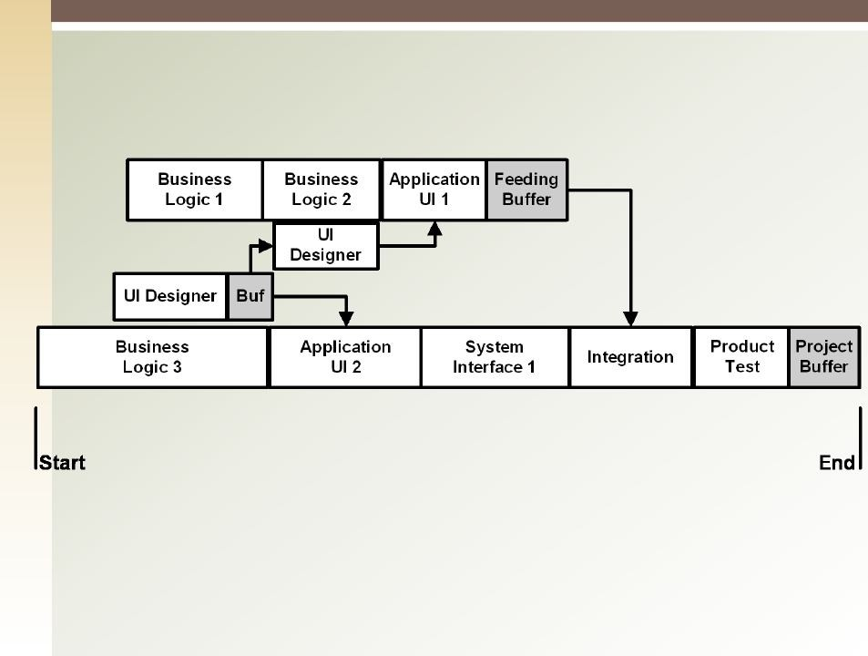

Critical Chain

Slide 50
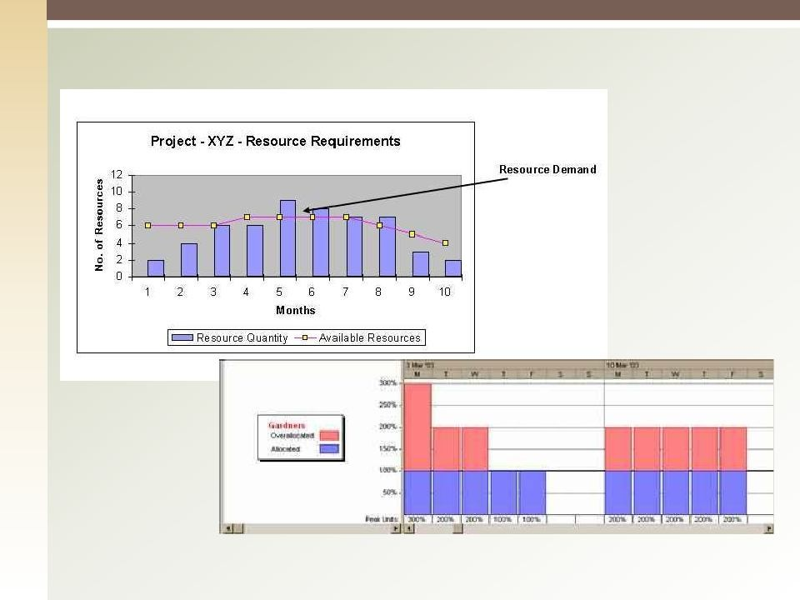
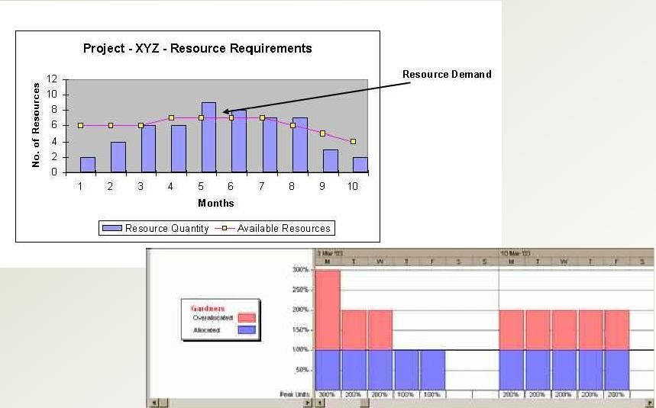
Resource Leveling & Smoothing

Slide 51
Duration Compression
Duration compression is a special case of mathematical analysis to shorten the project schedule without changing the project scope
Crashing : cost & schedule tradeoffs are analyzed
to determine how to obtain the greatest amount of compression for the least incremental cost.
Fast-tracking: doing activities in parallel that would
normally be done in sequence. Fast tracking often results in rework and usually increases risk.

Slide 52
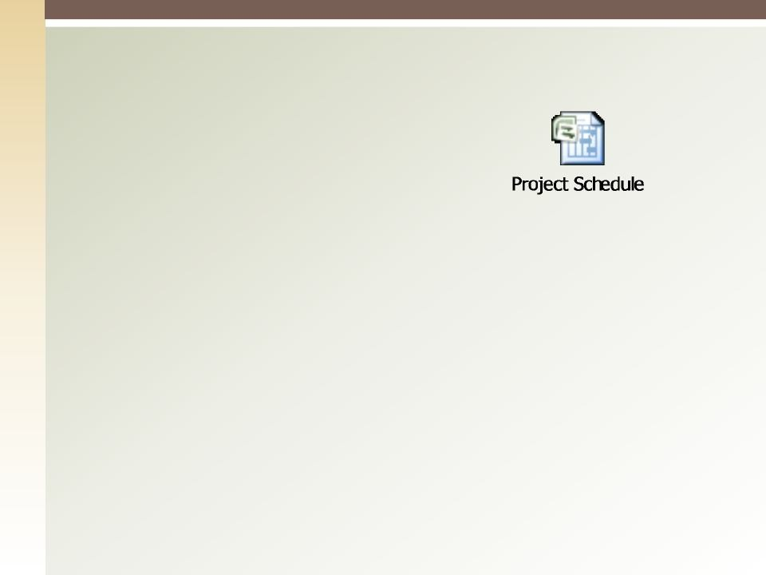
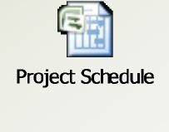
Develop Schedule: Outputs
Schedule Baseline
Project Schedule
Milestone Charts
Bar Charts
Schedule Network Diagrams
Schedule Data
Project Calendar
Project Management Plan Updates
Project Document Updates

Slide 53
Float
•
Total float (Slack): the amount of time an activity can be delayed without delaying the project end date or/and intermediary milestone.
Free Float (Slack): the amount of time an activity
can be delayed without delaying the start of its successor.
Project Float: the amount of time a project can be
delayed without delaying the externally imposed project completion date.
•
•

Slide 54


Quiz
Which of the following is the BEST project management tool to use to determine the longest time the project will take?
WBS
Network Diagram
Bar chart
Project Charter

Slide 55


Quiz
Which of the following is correct?
A schedule can have several critical paths
There must be only one critical path
The network diagram will change every time the end date changes
A project can never have negative float

Slide 56
6.6 Control Schedule
The process of monitoring the status of the
project to update project progress and manage changes to schedule baseline.
Concerned with:
Determine current status
Influence the factors that cause changes
Manage actual changes as they occur

Slide 57
Control Schedule: Inputs
Project Management Plan
Project Schedule
Work Performance Data
Project Calendars
Schedule Data
Organizational Process Assets

Slide 58
Control Schedule: T & T (1)
Performance Reviews
Trend Analysis
Critical Path Method
Critical Chain Method
Earned Value Management
Project Management Software
58

Slide 59
Control Schedule: T & T (2)
Resource Optimization Techniques
Modeling Techniques
Leads and Lags
Schedule compression
Scheduling Tool
59

Slide 60
Control Schedule: Outputs
Work Performance Information
Schedule Forecasts
Change Requests
Project Management Plan Update
Schedule baseline
Schedule Management Plan
Cost baseline
Project Document Updates
Organizational Process Assets Updates
59

Slide 61


Quiz
All of the following relate to controlling the
schedule EXCEPT:
Value analysis.
Crashing.
Float.
Mandatory dependencies

Slide 62



